Slide 1




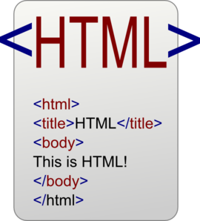

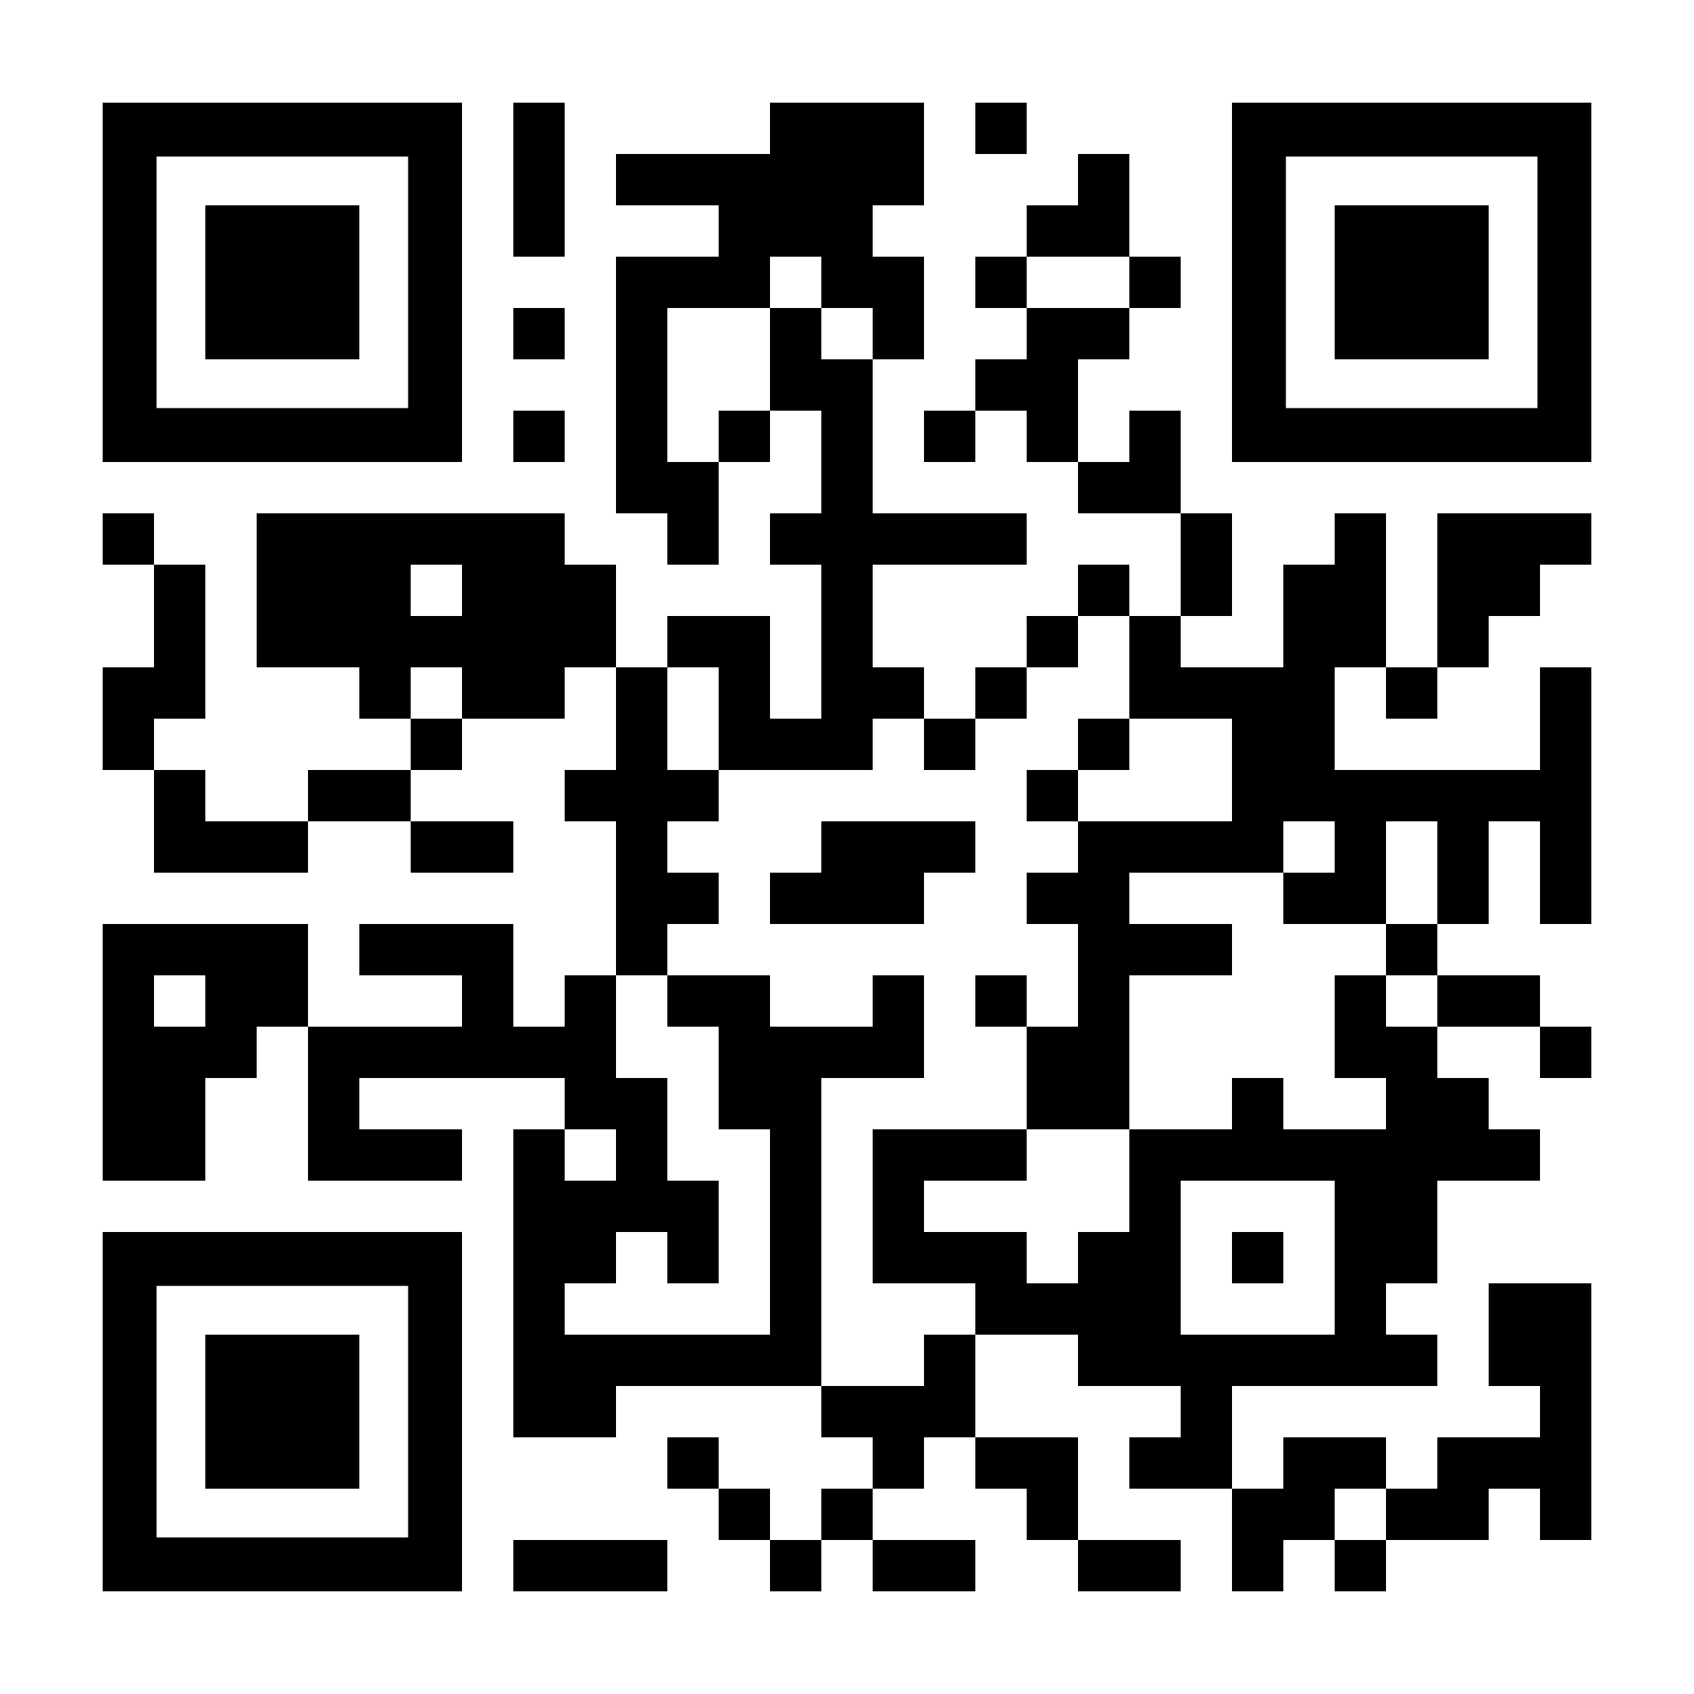





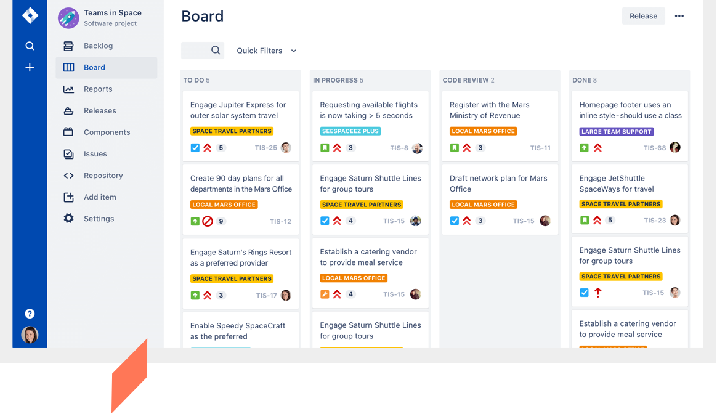

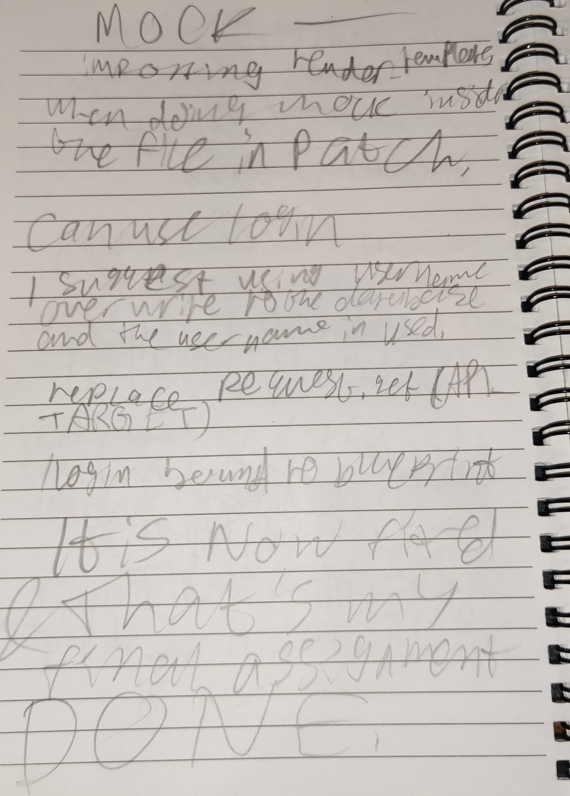
Joseph Liu
Software Engineering
Placement Overview
Professional IT Skills
I only needed
WHO ARE ONS?
SOFTWARE DEVELOPMENT (PROG) - LEVEL 2
The Office for National Statistics (ONS) is a civil service government organisation that produces publicly available statistics to the United Kingdom.
Their goal is ‘collecting, analysing, and disseminating statistics about the UK's economy, society, and population.’
Notable statistics by ONS include the population and demographic census every 10 years and the Coronavirus infection locations of Coronavirus in the UK.
Throughout the placement, I developed programmes to improve my own programming skills. I studied different functions, and modules and rated their viability for any assignments. The survey pages consisted of running Python and SQL scripts onto HTML pages and storing files with an AWS infrastructure, via Terraform.
FRONTEND
BACKEND
MY ROLES
During probation, I worked on an IPS survey website, involving tasks like modifying AWS resource names, job names, and action tasks.
I used two AWS-based Terraform files: main and variable. I changed or added resources to comply with criteria and discovered that backend code cannot directly reference frontend code.
By learning these infrastructure-based software, I was able to create Terraform based build plans ready to deploy onto an AWS server.
I was assigned to SPP (Statistical Production Platform) Results team who develops websites for filling in surveys, and algorithms for storing user-inputted responses and deployed the final survey product to the survey maker of ONS. My team collected information from other SPP teams, such as HTML files, Terraform resources, and AWS credentials.
Every day, I joined their daily meetings, where we discussed with a Jira board what each teammate was planning to develop each day. Every two days, we discussed the progress of an assignment on a ticket, which showed the status of a ticket, and dependencies on other tickets.
I paired with teammates on their assignments, shadowing them to teach me how software engineers work, such as HTML JavaScript. I recorded the methods used by my teammates and studied them afterwards. As a student with autism, I found it difficult to concentrate for a long or understand things immediately.
I participated in a teammate’s coding challenge every week to improve my coding skills, like condensing code within a time limit.
In May, I was put on probation to improve my Professional IT and Employability Skills. I was given 1-to-1 IPS (International Passenger Survey) assignments, to improve a travel traffic survey application.
This was done with lots of 1-to-1 help.
I improved on PROG by completing fun timed, code challenges in Python, which you can see on my GitHub account (QR code), as I completed more coding challenges, I required fewer revisions to my code which demonstrates in improvement. I also set SQL commands and HTML with JavaScript.
I used more Git commands such as branching. I also reviewed repos to follow standard layout conventions (like Python functions, classes and ONS design in HTML).
TESTING (TEST) - LEVEL 2 AND 3
I tested teammates and my own code. SPP used continuous integration to test code, which I adapted to use myself in my probation.
Concourse
I used Concourse and Docker to test Terraform builds. I deployed and edited the AWS resources, jobs, and job dependencies for triggering. Concourse checks each job with the 'get' command. If jobs fail, the build stops. Both Docker and Concourse log passed/failed tasks. Docker was used to set up a localhost of the survey website, so I could run GUI-based test cases.
I used Pytest, a testing framework that checks that all Python variables are valid. Using certain arguments allowed me to refine how Pytest tests Python code. When a test fails, Pytest tells me what was wrong, allowing me to correct errors efficiently. I also used PDB, a similar tool that enables testing on localhost webpages.
EXAMPLE JIRA BOARD
Employability Skills
Advice for Placement Students
I developed my employability skills adequately, by collaborating with others, especially my probation teammate and others to find improvements that could be implemented into code initiated by other teams based on task criteria.
BEFORE YOUR PLACEMENT
ADVICE FOR YOUR CV
Add your coding portfolio to your CV, like links to your Github repo, so employers know your skills and abilities. Also, the university has a CV checker to ensure you put in the most relevant details of your CV, and fix any errors in your CV.
AUTONOMY
I often had help from teammates throughout the completion of assignments. However, during the placement, I started developed code and troubleshooting on my own.
For instance, I had found a bug in the IPS file upload page and took it upon myself to identify the problem with the code. A function called ‘FileRequired’ would be called upon when I submit without filling in all the needed variables. However, if resubmitting with all variables filled, the function was mistakenly still called. Therefore, I collaborated with a teammate to create an overwriting class that would correctly call ‘FileRequired’.
INFLUENCE
Throughout the placement, I influenced meetings regularly by asking some questions relating to the task, sometimes asking for clarification relating to tasks, in which they often gave details they initially missed out, at other times I made suggestions that would prompt a discussion into our methodologies.
One of my suggestion to SPP was to use KANBAN instead of AGILE in Jira, because it would allow the user to break down tasks into manageable subtasks, ranking their importance leading to more efficient code creation. The team approved using KANBAN, have been using it since.
MOCK INTERVIEWS
The more interviews you do, the more confident you will be answering questions. Train on simple computing questions like ‘what are decorators in Python?’
When asked about the time you used a skill, use STAR. Stick to one or two detailed examples; employers love details. Show yourself off!
BUILD UP YOUR SKILLS
Make sure you attend clubs, network seminars, and workshops to build up your employability skills. If you get rejected from a placement, ask for feedback. You are more likely to get accepted in the future if you apply that feedback.
ON YOUR PLACEMENT
WAIT ON ASSIGNMENTS
Expect to be transferred to different teammates if there is no work for you. That does not mean you are doing bad; it means you had done everything the original team wants. While you wait for new assignments, you should research programming and training materials, so you are prepared for upcoming assignment. Then, when your get a project, you can complete them with your teammates, with your newly acquired knowledge.
BUSINESS SKILLS
In this placement, I have shown my communication skills, especially during meetings with my teammates. I knew when it was the right time to talk or listen and would prompt useful discussions.
Over the course of my placement, I improved on my use of tools standards, methods and applications. For example, I now know how to use Pytest to test variable validity in Python, which is especially useful for debugging.
COMPLEXITY
After completing the probation training and testing code, I was able to follow IPS protocol regarding deploying Concourse build plan with two environments.
I received some assistances when requiring to do more complex task, such as dynamic Concourse Deploy commands, such as the User Acceptance Testing and Sandbox environment on different build plans.
ASK FOR HELP
When you are stuck on a task, ask for someone to pair with you so then you can learn how your teammate accomplishes that task, and you will learn to use their methods when completing similar tasks. Be sure to note them down to help you remember and improve your autonomy. Your team will look out for you!
PRIVATE THOUGHT DIARY
Create a diary of all assignments, the timeline, and how well you done them, and what would you do next time if you do similar assignments.
If possible, take pictures or videos of your work and demonstrations by others. Get the manager’s consent first. Things you cannot record should be written in your notes like methods and commands.
A diary will help you recall everything for your reflective report and on your poster/video next year.
Notes:
Don’t try to include too much information from your Reflective Report in your poster. You don’t need to cover all of your achievements and skills. Instead focus on those achievements and skills that are particularly interesting or significant or those where you made most progress. Don’t try to clutter your poster with too much text. Images from your placement can also add interest but make sure you have permission from your employer to use them in your poster.
Make the poster with 1: professional writing style so that all the content is textually correct and clear to the target audience.
2: excellent visual quality, imagination and creativity whilst remaining professional

